Slide 1
WELCOME to the Microsoft & Intel IoT Camp!
Come on it, find a seat, and get comfortable!
We have a great day planned!
8:30am | Registration / Welcome
9:00am | Introduction to Microsoft Azure IoT Services
10:00am | Introduction to the Intel IoT Gateway
11:00am | Hands-On-Lab
12:00pm | Lunch Served
Afternoon | Hands-On-Lab Continues
4:30pm | Make sure to complete your Eval!
5:00pm | End of Event

Slide 2
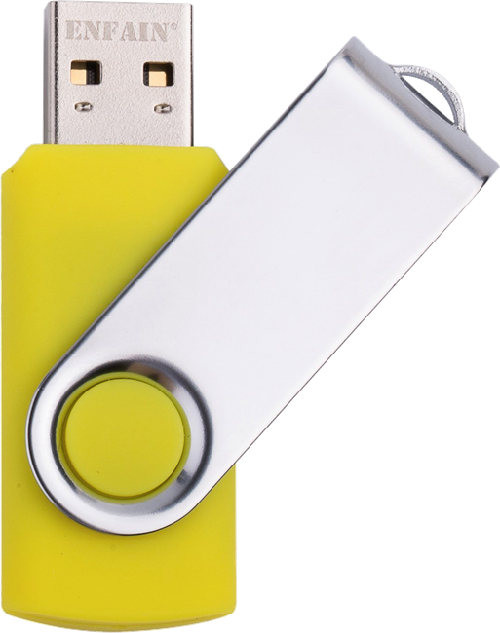

USB STICKs
There are Yellow USB Sticks being passed around.
Please copy, not move, the contents to your computer and pass the stick on to your neighbor.
PLEASE DO NOT TAKE THE USB STICKS!
We got to a lot of effort to make these, please help make them available to future attendees!

Slide 3
PLEASE CONNECT TO WIFI
PLEASE DO NOT CONNECT YOUR LAPTOP TO THE ETHERNET CABLES AT YOUR TABLE. THE ETHERNET CONNECTION IS REQUIRED BY THE INTEL GATEWAY DEVICE YOU WILL USE IN THE LAB.
SSID: MSFTOPEN
Password: None. Open Browser to Connect
Development Workstation (Windows / OSx / Linux)
MSFTOPEN
Intel NUC / IoT Gateway

Slide 4
Verify your azure subscription
You will need an active Azure Subscription to complete the lab.
You can sign up for a free trial at: http://azure.com/free
If you have already used a free trial in the past:
Open a private browser session.
Go to outlook.com and create a new free outlook.com email address
Sign up for the free Azure Trial using that new outlook.com email address
If you have an existing subscription you wish to use you may do so. While the services you will configure in the lab are inexpensive, there are costs associated. You could expect to be billed appx $5 USD per day for normal usage of the services The cost could be higher with excessive usage..

Slide 5
Stay current with the content
We have the latest content for you on the USB drives here at the event, however in the future:
The content is available on GitHub at:
http://github.com/dxcamps/MicrosoftIntelIoTCamp
You can download a a.zip file with the most recent content from:
http://github.com/dxcamps/MicrosoftIntelIoTCamp/releases/latest

Slide 6
GET What you need for the labs…
Now is a great time to setup or install these if you don’t have them already. There are copies of the software on the yellow USB drives…
An active Microsoft Azure Subscription.
Node.js 4.x or later. You can install Node.js from nodejs.org
Visual Studio Code. You can install it from code.visualstudio.com
Git installed and in your system path. Install it from:
git-scm.com/downloads or if you prefer GitHub…
desktop.github.com
Make sure your git global config is setup: git config --global user.name "Your Name“ git config --global user.email "Your Email"

Slide 7
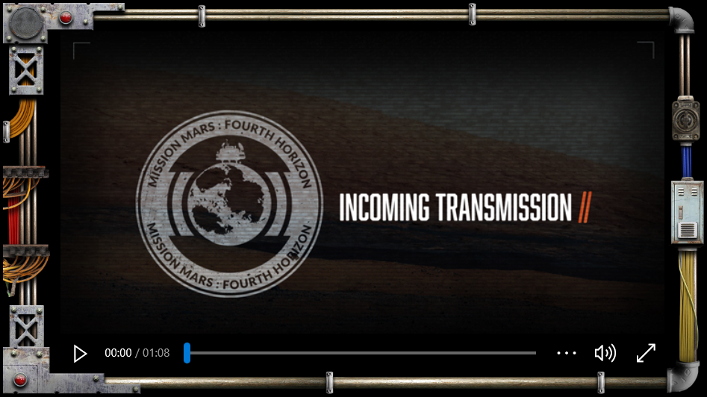
Earth’s Mission to Mars is in jeopardy. Will you answer the call?
MISSION LOCATION | DATE
LOS ANGELES | FEB 28
SAN FRANCISCO | MAR 9
CHICAGO | MAR 14
AUSTIN | MAR 26
SEATTLE | APR 19
BOSTON | APR 20
NEW YORK | MAY 02
PHILLY | MAY 17
ATLANTA | MAY 23
Register: MissionMars.Microsoft.com

Slide 8
Microsoft & Intel | IoT Camp Attendee Evaluation
Please take a few minutes to answer our short survey BEFORE you leave the event today!
To receive the evaluation link for this event, text MICROSOFT CALI to 878787. By doing so you agree that Microsoft can send you an automated message to this mobile phone.
If unable to access the evaluation through the QR code on your name badge, you can access the evaluation here: http://aka.ms/IoTCampCA
Provide the email you used to register for this event, select the attendee evaluation and complete the evaluation.
Thank you for your feedback!
© 2016 Microsoft Corporation. All rights reserved. Microsoft, Windows, Windows Vista and other product names are or may be registered trademarks and/or trademarks in the U.S. and/or other countries.
The information herein is for informational purposes only and represents the current view of Microsoft Corporation as of the date of this presentation. Because Microsoft must respond to changing market
conditions, it should not be interpreted to be a commitment on the part of Microsoft, and Microsoft cannot guarantee the accuracy of any information provided after the date of this presentation.
MICROSOFT MAKES NO WARRANTIES, EXPRESS, IMPLIED OR STATUTORY, AS TO THE INFORMATION IN THIS PRESENTATION.

